Slide 1

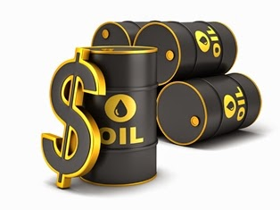
Supercritical Water Desulfurization
By:Simin Espootin
Supervisor:Prof.Ghaziaskar
1394/05/14

Slide 2
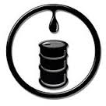

Outline:
Introduction
SCW treatment of crude oil
SCWD
Mechanisms
SCWD setup
Conclusion
2

Slide 3
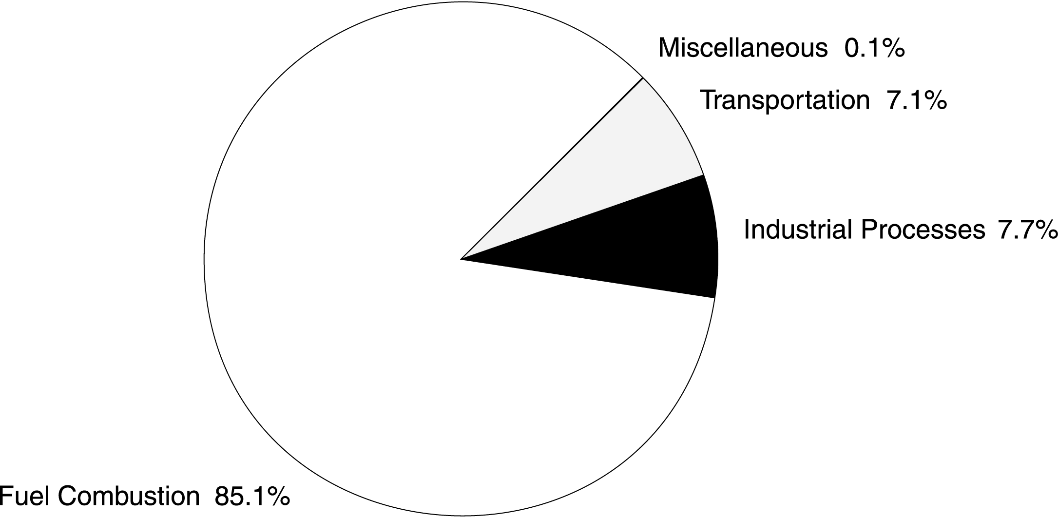
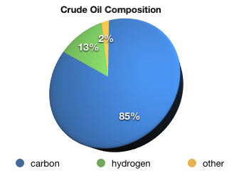
1.22%
90% SO2
3

Slide 4
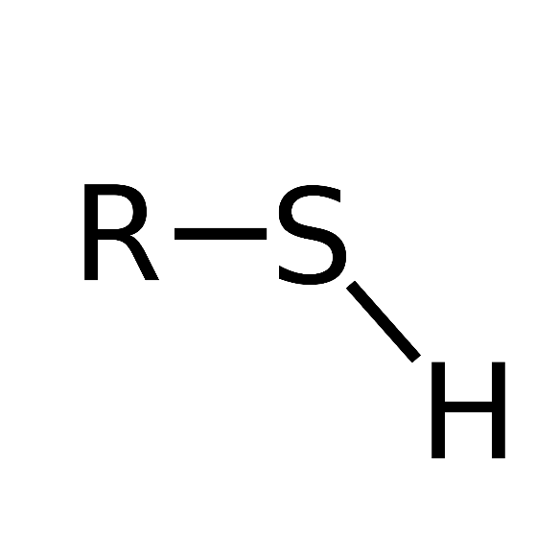

Sulfur compound in crude oil
Aliphatic Sulfur Compounds
R -S - R‘
Disulfides
Thiols
Sulfides
Desulfurization of heavy oil .Rashad Javadli • Arno de Klerk
4

Slide 5
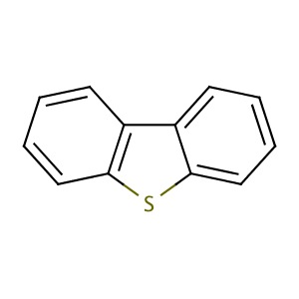
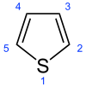
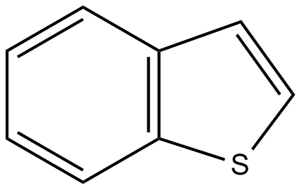
Sulfur compound in crude oil
Thiophenic Compounds
Thiophene
Benzothiophene
Dibenzothiophene
Desulfurization of heavy oil .Rashad Javadli • Arno de Klerk
5

Slide 6
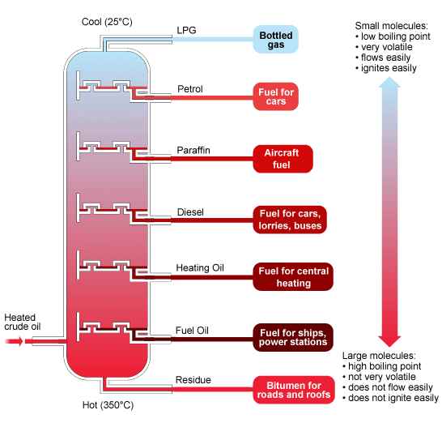
Name | Number of Carbon Atoms | Boiling Point (°C) | Uses
Refinery Gas | 3 or 4 | below 30 | Bottled Gas (propane or butane).
Gasoline | 7 to 9 | 100 to 150 | Fuel for car engines.
Naphtha | 6 to 11 | 70 to 200 | Solvents and used in gasoline.
Kerosene (paraffin) | 11 to 18 | 200 to 300 | Fuel for aircraft and stoves.
Diesel Oil | 14 to 18 | 200 to 300 | Fuel for road vehicles and trains.
Lubricating Oil | 25 to 35 | 300 to 400 | Lubricant for engines and machines.
Fuel Oil | 36 to 44 | 350 to 450 | Fuel for ships and heating.
Greases and Wax | 40 to 52 | 400 to 500 | Lubricants and candles.
Bitumen | above 55 | above 500 | Road surface and roofing.
Fractions of Crude Oil
6

Slide 7
Normal Sulfur
High Sulphur
Low Sulfur
0.5-1.0%
1.0-2.0%
2.0-3.5%
7

Slide 8
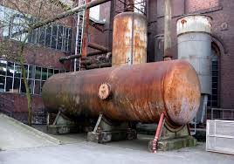
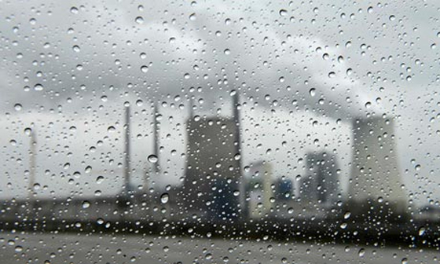
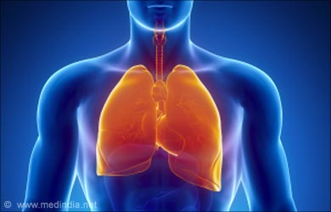
Effect Of Sulfur
Air pollution
Corrosion
Catalyst performance
Human Health
8

Slide 9
Different methods of Desulfurization of crude oil
1
1
Desulfurization with metals and their compounds
1
2
Oxidative desulfurization (ODS)
3
Hydro desulfurization (HDS)
4
Desulfurization by chemical methods
5
Bio desulfurization(BDS)
6
Supercritical water desulfurization(SCWD)
9

Slide 10
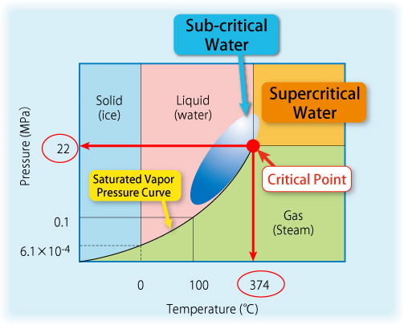
Supercritical Water
10

Slide 11
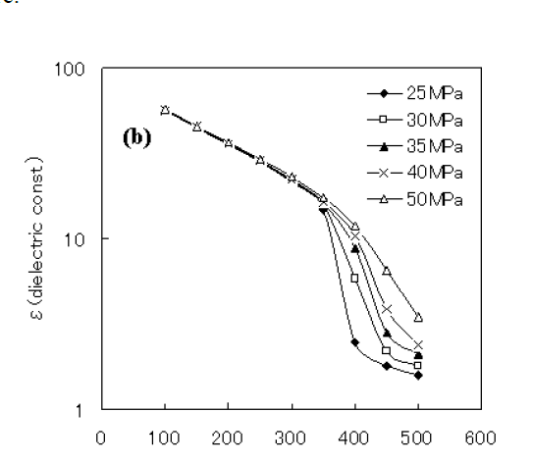
Properties of Supercritical Water
1
2
3
4
SCW can be mixed with oxygen, hydrogen, and most hydrocarbons in any proportion
solubility properties
due to
the low
dielectric constant
Self-ionization properties
SCW has a high solubility for
organics and
decreased solubility for inorganic
Ionic compounds
Supercritical Water Desulfurization of Crude Oil
byYuko Kida
11

Slide 12
SCW+Aromatic S-compound: No Desulfurization
Thiophenes & Benzothiophenes
Unreacted in SCW at 460⁰C-1h
SCW at 300⁰C& 8.6MPa only 0.75% conversion after 28 days
12
Notes:
تلاشهای فراوانی جهت گوگرد زدایی از طریق آب فوق بحرانی انجام شده است و واکنش در شرایط مختلف مورد سنجش قرارگرفته

Slide 13
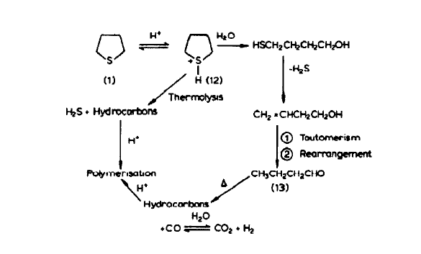
SCW+ S-compound + Acid: Some Desulfurization
Sulfuric acid
Aromatic sulfur
compound
240⁰C&3.35MPa
14% and 10%
desulfurization
after 14 days
Supercritical Water Desulfurization of Crude Oil
byYuko Kida
13

Slide 14
SCW+S-compound+Base: Some Desulfurization
S-compound
supercritical KOH solution
430⁰C
30MPa
60%reduction of total sulfur
Product contains:
S⁻²,Carboxylic acids, CO₂
14

Slide 15
Supercritical water + S-compound + Metal Ions: Desulfurization
S-compound
Various metal ions
Supercritical Water
Aluminum ion(Al⁺³)
First-row transition metal cations(Sc⁺³,Cr⁺³,Fe⁺²,Co⁺²)
Sulphates or chlorides of Group VIIIB metal cations(Ru⁺³,Rh⁺³,Ni ⁺²,Pd ⁺²,Pt⁺⁴)
15

Slide 16
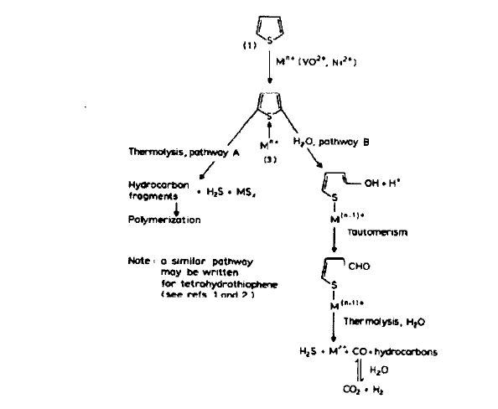
16

Slide 17
SCW+S-compound+HDS catalyst + Various gases (H2 , CO, CO 2 ): Desulfurization
SCW
(400C&
30MPa)
HDS catalysts (NiMo/Al₂O₃)
-DBT is desulfurized in CO+SCW, H2 +SCW, and CO 2+H2+SCW in the presence of HDScatalysts, with H2+SCW being the least
Reactive
-Introduction of CO is more effective in desulfurizing DBT
than H2 is in the presence of HDS catalysts
-CO can be generated by partial oxidation of hydrocarbons
in SCW in the presence of HDS catalysts
17

Slide 18
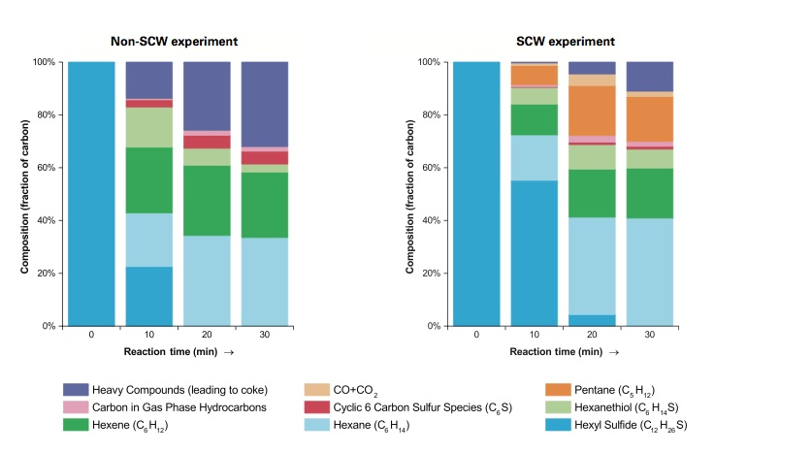
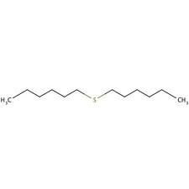
Hexyl Sulfide Decomposition
hexyl sulfide
Heated Hexyl
Sulfid without adding water
Mixed the
Hexyl sulfide with SCW
Upgrading and desulfurization of heavy oils by supercritical waterMichael T. Timkoa,∗, Ahmed F. Ghoniemb, William H. Greenc
17

Slide 19
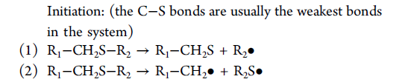
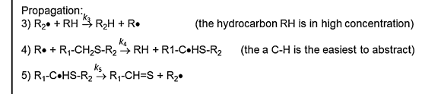
Reaction Mechanisms
Upgrading and desulfurization of heavy oils by supercritical waterMichael T. Timkoa,∗, Ahmed F. Ghoniemb, William H. Greenc
18

Slide 20
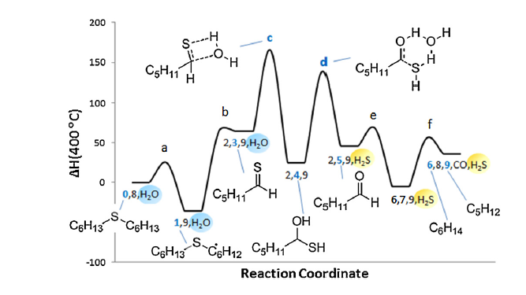
Upgrading and desulfurization of heavy oils by supercritical waterMichael T. Timkoa,∗, Ahmed F. Ghoniemb, William H. Greenc
19

Slide 21
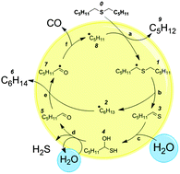
In step C, water adds to a Thioaldehyde to make a geminal Mercaptoalcohol
In step D water catalyzes the
fragmentation of Mercaptoalcohol into an Aldehyde plus H2S.
Supercritical Water Desulfurization of Crude Oil
byYuko Kida
20

Slide 22
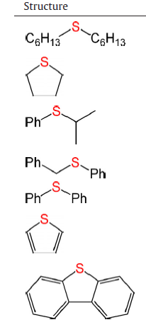
Reactivity of sulfur compounds in SCW
% S removal
Hexyl sulfide
25
Tetrahydrothiophene
16
Isopropyl phenylsulfide
30
Benzyl phenylsulfide
22
<5
Diphenyl sulfide
Thiophene
<5
Dibenzothiophene
<5
21

Slide 23
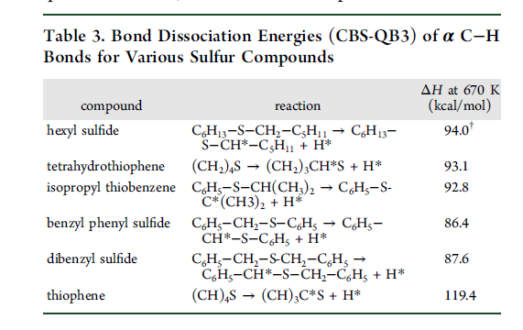
Reactivity Sulfur Compounds
Relative Strengths of α C−H Bonds
Strength of the S−R band
4.Supercritical Water Desulfurization of Organic Sulfides Is Consistent
with Free-Radical Kinetics
. Bonomi,† Yuko Kida,†
22

Slide 24
Three-dimensional Computational Fluid Dynamics (CFD)
A method of simulating fluid flows within a well-defined region
SCW flows through the horizontal pipe, and cold oil is injected into it through a vertical pipe.
Initial interaction between the two streams causes the formation of two coherent swirls called vortices—rotating structure
CFD Modeling and Simulations in a 3-D Reactor Geometry Ashwin Raghavan, Guang Wu, Michael T. Timko
23

Slide 25
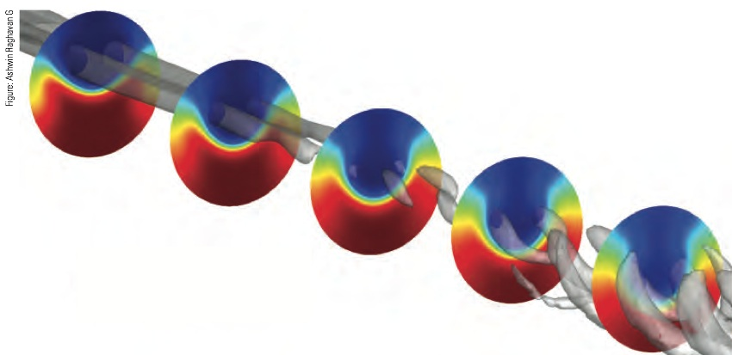
CFD Modeling and Simulations in a 3-D Reactor Geometry Ashwin Raghavan, Guang Wu, Michael T. Timko
24

Slide 26
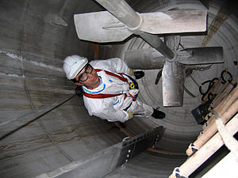
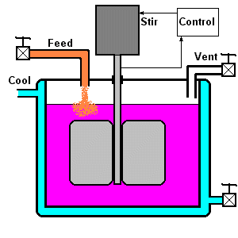
Continuously fed stirred-tank reactor (CSTR)
Run at steady state with continuous flow of reactants and products
The feed assumes a uniform composition throughout the reactor
Good temperature control
25

Slide 27
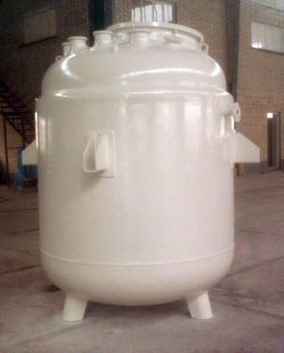
Reactor Construction
leaked less frequently had much thinner walls, making heat transfer faster.
gram of reactant
Requires about a
Sitek reactor
Gas phase product collected easily
by gas sampling bag
26

Slide 28
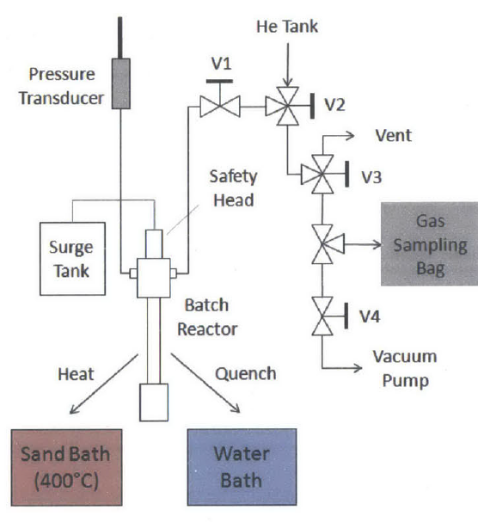
Supercritical Water Desulfurization of Crude Oil
byYuko Kida
27

Slide 29
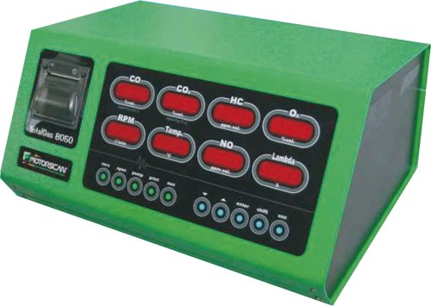
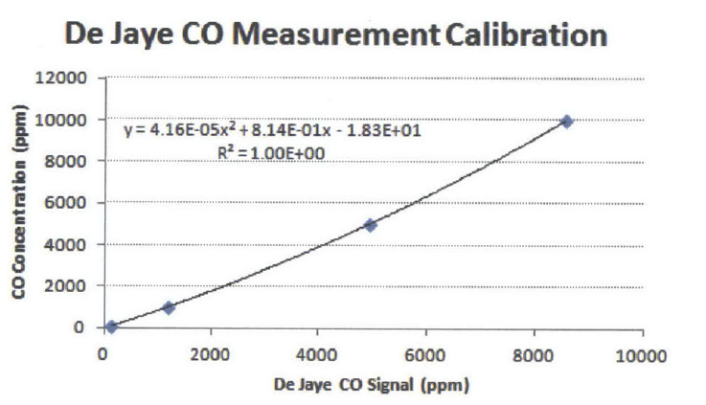
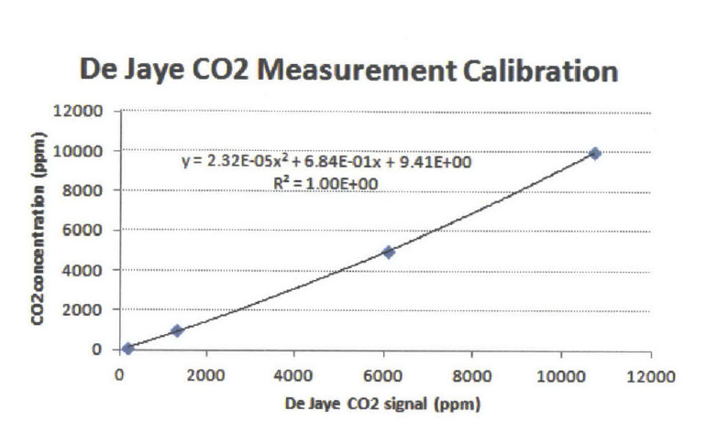
De Jaye Analyzer
Analyzing CO, CO 2 , H2, H2 S, and O2
CO and CO2concentrations beyond 1%gas product is diluted in helium and this mixture is analyzed on the De Jaye analyzer
Supercritical Water Desulfurization of Crude Oil
byYuko Kida
28

Slide 30
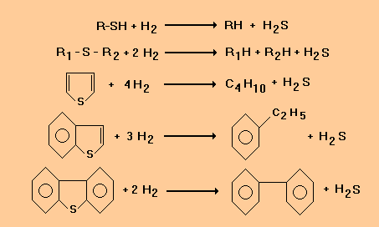
Hydro Desulfurization (HDS)
standard HDS catalysts :
Ni Mo/ Al₂O₃- Co Mo/Al₂O₃
29

Slide 31
Problems in HDS
High metal content, which causes deposit formationand catalyst deactivation.
Molecular size, which limits access to smaller catalyst pores.
Steric protection of thiophenic sulfur, making adsorption for HDS difficult
Excess hydrogen needed
30

Slide 32
Problems in SCWD
Aromatic sulfur compounds do not react in SCW.
Chemically environment, which can rapidly de-activate many catalysts.
31

Slide 33
Scw Desulfurization Process Advantages :
dilution, precipitation of sulfur-rich species
H₂ production by water gas shift
without using hydrogen that would reduce costs, energy use.
reduces sulfur content and decreases average molecular weight without rejecting carbon as coke products
32

Slide 34
Conclusions
Remove up to 30−50% of the sulfur from crude oil
without the external addition of hydrogen and catalyst
Thiophenic rings themselves are not broken (desulfurized) in the treatment.
Key unknowns about the SCW desulfurization process
Sulfur reduction, decrease in density and viscosity on real fuel mixtures
33

Slide 35
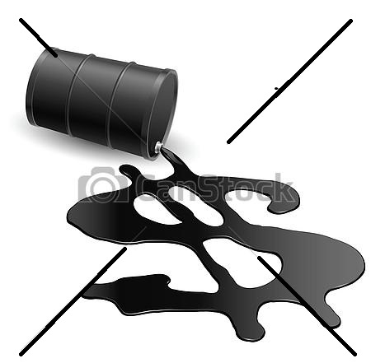
Future Outlook
Improved process data and economic models
Identification of cost-effective catalysts with high activity and stability
linking SCW processing with other environmentally friendly desulfurization
Improved understanding of the chemistry of heavy components
34

Slide 36

Reference
1.Upgrading and desulfurization of heavy oils by supercritical waterMichael T. Timkoa,∗, Ahmed F. Ghoniemb, William H. Greenc
2.The role of catalyst in supercritical water desulfurizationAyten Atesa,b, Gisele Azimic, Ki-Hyouk Choid, William H. Greena,∗, Michael T. Timkoa,
3.Desulfurization of heavy oil .Rashad Javadli • Arno de Klerk
4.Supercritical Water Desulfurization of Organic Sulfides Is Consistent
with Free-Radical Kinetics
Pushkaraj R. Patwardhan,†,∥ Michael T. Timko,†,⊥ Caleb A. Class,† Robin E. Bonomi,† Yuko Kida,†
35

Slide 37

Reference
5.Supercritical Water Desulfurization of Crude Oil
byYuko Kida
B.S., Chemical Engineering. University of California at Berkeley, 2007
6. Applicability of supercritical water as a reaction medium for
desulfurization and demetallisation of gasoil. Vogelaar BM, Makkee M, Moulijn JA, Fuel Process Technol, Vol. 61, 1999, pp. 265–277.
7. Catalytic hydrodesulphurization of dibenzothiophene
through partial oxidation and a water-gas shift reaction in supercritical water. Adschiri T, Shibata R, Sato T, Watanabe M, Arai K Ind Eng Chem Res, Vol.
36

Slide 38



