Slide 1

Conversion of Carbon Dioxide to Products of Value
M. Sc. Seminar
Presented by: Amin Javaheri Koupaei
Under supervision of: Dr. H. S. Ghaziaskar

Slide 2
Contents
CO2 Release Summary
Why CO2 Conversion is Needed ?
The Feasibility of Carbon Dioxide Conversion & Activation
Important Reactions of CO2
Conclusions
References

Slide 3
Release Summary
CO2 release rate
Effects of the release

Slide 5
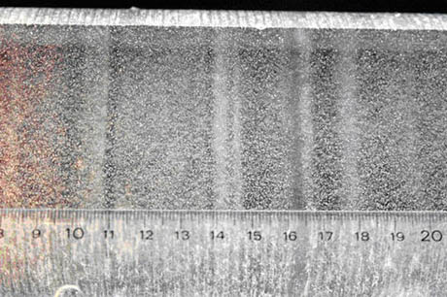
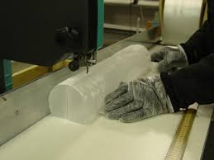
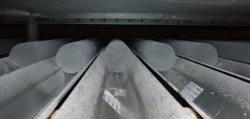
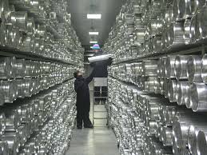
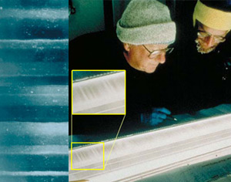
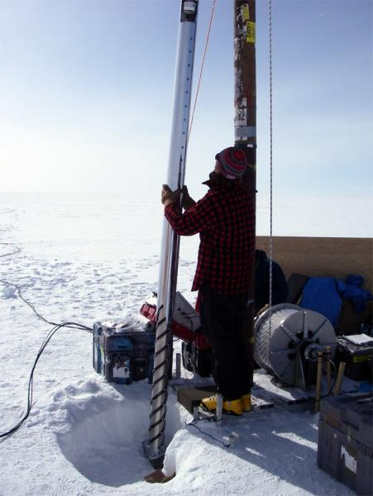
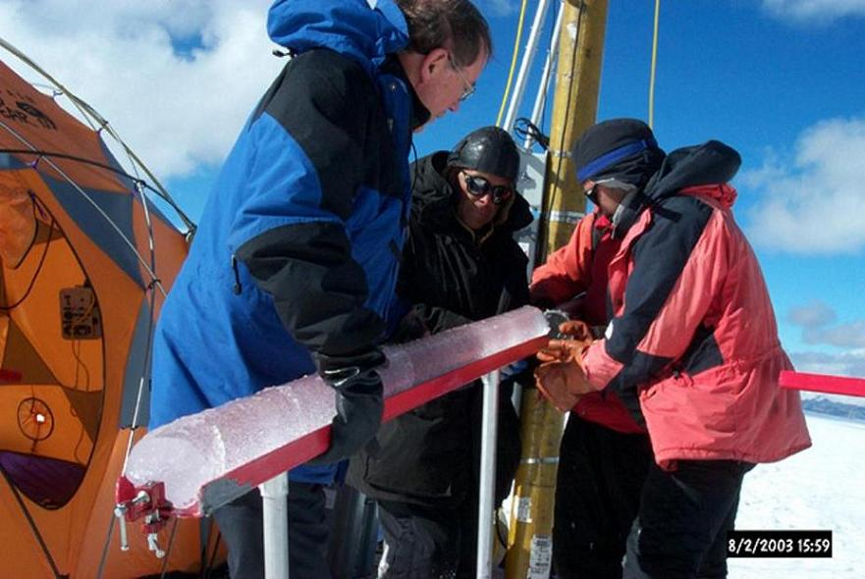
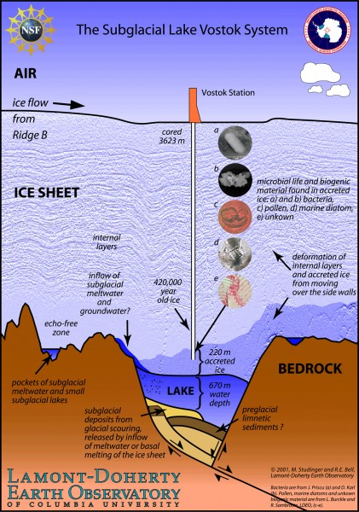

Slide 7
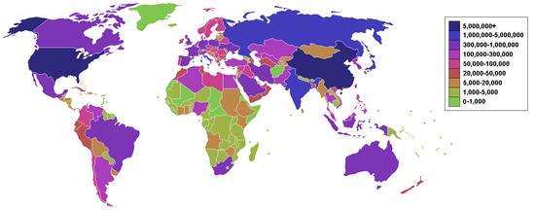
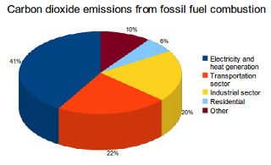
Notes:
Countries by carbon dioxide emissions in thousands of tonnes per annum, via the burning of fossil fuels (blue the highest).

Slide 8
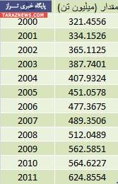
Country | Annual CO2 emission (in thousands of tons) | % of world emission | reference
World | 29,888,121 | 100% | UN
China | 7,031,916 | 23.5% | UN
United states | 5,461,014 | 18.27% | UN
European Union(27) | 4,177,817 | 13.98% | UN
India | 1,742,698 | 5.83% | UN
Russia | 1,708,653 | 5.72% | UN
Japan | 1,208,163 | 4.04% | UN
Germany | 786,660 | 2.63% | UN
Canada | 544,091 | 1.82% | UN
Iran | 538,404 | 1.8% | UN
UK | 522,856 | 1.75% | UN
… | … | … | …
Nieu | 4 | 0% | UN

Slide 9
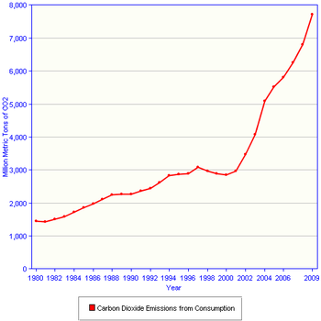

Slide 10
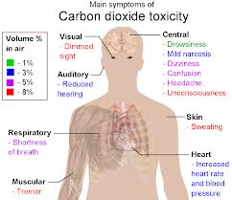
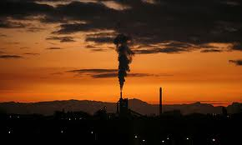

Effects of the Release
Health problems
Environmental concerns
Loss of money

Slide 11

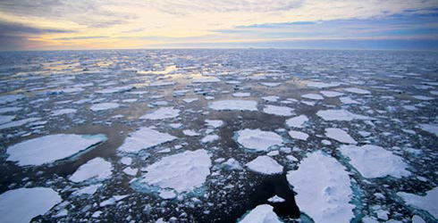

Evidence of Critical National Need and Policy
Climate change
Consequences of climate change
Energy independence

Slide 12
Facing CO2
Capture
Storage
Utilization

Slide 13

Large Scale CO2 capture

Slide 14
CO2 capture
Amine-based scrubbing solvents
Ionic liquids
Solid sorbents
a) Amine-based solid sorbents
b) Alkali earth metal-based solid sorbents
c) Alkali metal carbonate solid
sorbents

Slide 15
The process flow diagram of post-combustion capture using the calcium looping cycle

Slide 16
The Feasibility of Carbon Dioxide Activation and Conversion
CO2 conversion
Alternative solutions:
Sequestration and storage
Agricultural Modification & Reforestation
Energy Conservation
Alternative Energy

Slide 18
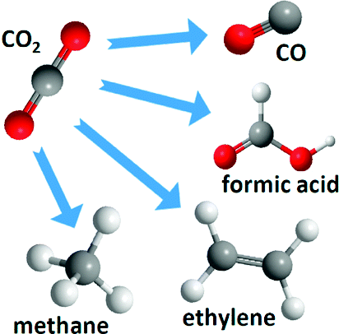
Common CO2 conversions

Slide 19
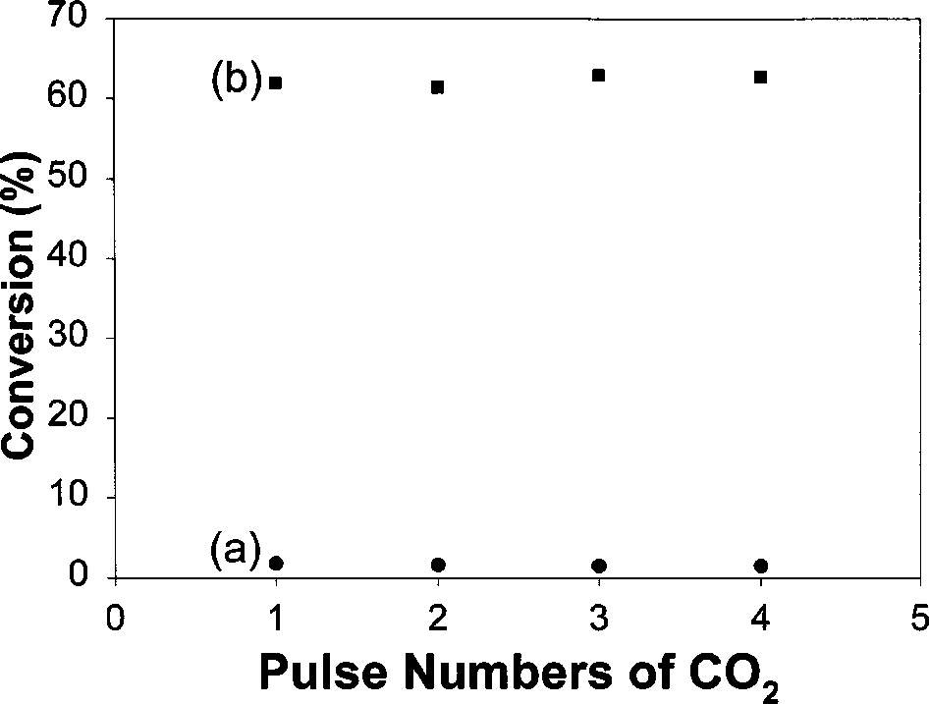
CO2 to CO
CO formation in reverse water–gas shift reaction over Cu/Al2O3 catalyst
CO₂ + 2Cu → Cu₂O + CO
H₂ + Cu₂O → Cu⁰ + H₂O
The conversion of CO₂ to CO
at 773 K over a Cu/Al₂O₃ catalyst,
1 mL pulse feed in (a) He &
(b) H₂ stream at 60 mL/min
Notes:
**The mechanism of the reverse water–gas shift reaction over a Cu catalyst was studied by CO₂ hydrogenation, temperature-programmed reduction of the Cu catalyst and pulse reaction with QMS monitoring. In comparison with the reaction of CO₂ alone, hydrogen can significantly promote the CO formation in the RWGS reaction. The formate derived from association of H₂ and CO₂ is proposed to be the key intermediate for CO production. Formate dissociation mechanism is the major reaction route for CO production. Cu(I) species were formed from the oxidation of Cu⁰ associated with CO₂ dissociation.
**Carbon dioxide, mostly generated from combustion, is the most important greenhouse gas, which causes global warming. The increase of carbon dioxide concentration will strongly influence the equilibrium condition of weather and environment on earth. It has been important to reduce the release of CO₂ and recycle CO₂. Conversion of CO₂ to CO by catalytic hydrogenation has been recognized as one of the most promising processes for CO₂ utilization. In industry, synthesis gas, H₂ and CO, can be used to produce longchain hydrocarbons via the Fischer–Tropsch reaction [1,2]. The reverse water–gas shift reaction is one of the available methods for production of CO.
The mechanisms of the water–gas shift (WGS) and reverse water–gas shift (RWGS) reactions over Cu-based catalysts have been discussed, but they are still controversial [3–14]. Two models, the redox and formate decomposition mechanisms, were proposed to explain the mechanism of CO formation in the RWGS reaction. For the redox mechanism, the concept of the oxidation and reduction cycle was suggested. CO₂ oxidized Cu⁰ and generated CO. H₂ reduced Cu(I) to Cu⁰ and formed H₂O [3–5]. CO can be produced from CO₂ alone over Cu powder or Cu/ZnO catalyst. The reactant, H₂, plays a role of reducing reagent for reduction of Cu₂O. In the other model, the formate decomposition mechanism, it was suggested that CO could be formed from decomposition of a formate intermediate derived from hydrogen associated with CO₂ [10,12]. It has been reported that CO production rate increased with the concentration of formate species on Cu.
The purpose of this paper is to study the pathway of CO formation in the RWGS reaction in more detail. The mechanism of the RWGS reaction was studied on a
∗ To whom correspondence should be addressed.
 J.C. Baltzer AG, Science Publishers
Cu/Al₂O₃ catalyst by using CO₂ hydrogenation, temperature-programmed reduction of the Cu catalyst and pulse reaction with QMS monitoring. Both feeds of CO₂ alone and H₂/CO₂ mixture were used to compare the difference in catalytic activity and TPR profiles of the catalyst for postreaction. Our experimental results will be used to examine the redox and formate decomposition pathways and provide a reasonable reaction mechanism.

Slide 20
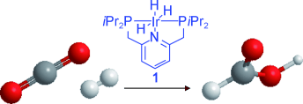
CO2 to formic acid
CO2 + H2 ➔ HCOOH
(Using Ru, Ir catalysts, can directly accelerate the reaction)

Slide 21
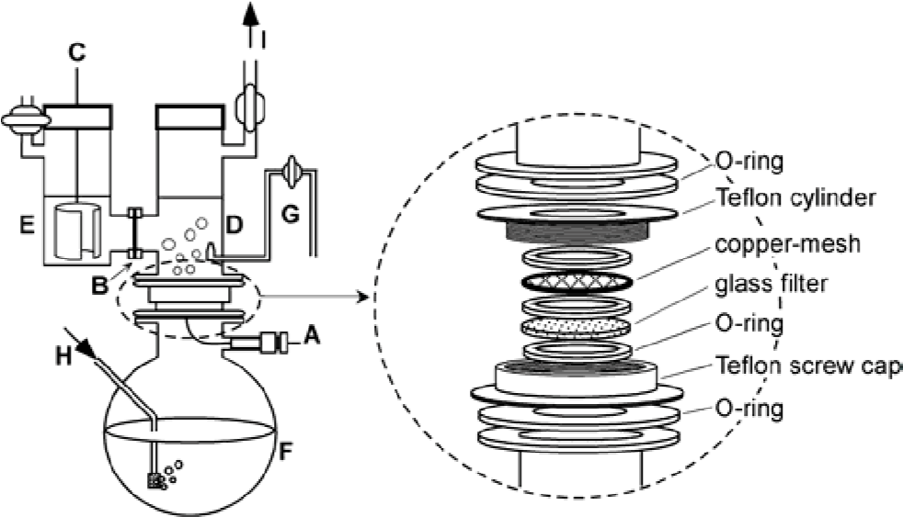
CO2 to ethylene
Schematic diagram of an electrolysis cell. A, working electrode (copper-mesh); B, cation-exchange membrane; C, counter electrode; D, cathode compartment; E, anode compartment; F, reservoir; G, Luggin capillary; H, gas inlet; I, gas outlet.
Notes:
**Experimental
The electrolysis cell used was schematically shown in Figure 1.
The three-phase interface was constructed on a pure copper-mesh (purity 99.99%, 50 mesh, Nilaco Co.). The copper mesh put on a glass filter (average pore size, 20µm) was bound to a Teflon cylinder tightened with a Teflon cap. The cylinder with the copper-mesh was attached to a cathode compartment via an O-ring, which was separated from an anode compartment by a cation-exchange membrane (Selemion CMV 10, Asahi Glass Co.). The bottom of the Teflon cap was fixed to a reservoir containing the same solution as that used in the cathode compartment via an O-ring. The purified CO₂ gas was blown up onto the Cu-mesh through the glass filter from the bottom of the cell, and the reaction gas was circulated via the cathode compartment with a circulating pump. The gas/liquid/solid phase provided on the Cu-mesh electrode was sustained during the electrolysis by adjusting the rate of CO₂ flow, and the net surface area was 10.2cm². Before each experiment, the Cu-mesh electrode was immersed to remove Cu oxide in concentrated HCl, and washed with doubly distilled water and then with electrolytic solution in an ultrasonic bath. A platinum plate and an Ag/AgCl/saturated KCl electrode were used as the counter and reference electrodes, respectively. The electrolytes used were 3M KCl or KBr solutions
**containing various concentrations of CuSO₄. The anolyte was always a 0.5M KHSO₄ solution of pH 0.
Gaseous products were analyzed with a Shimazu GC-8AIT and a GC-8AIF gas chromatograph. A Shimazu GC-MS spectrometer and an organic acid analyzer were used to analyze aqueous products. The electrode surface after the electrolysis was observed by FE-SEM and EPMA techniques.

Slide 22
CO2 to methanol
CO₂ + 3 H₂ → CH₃OH + H₂O
CO₂ → CO + ½ O₂
CO + 2H₂ → CH₃OH
Over Cu/Zn/Al/Zr fibrous catalyst
Notes:
**A highly active Cu/Zn/Al/Zr fibrous catalyst was developed for methanol synthesis from CO₂ hydrogenation. Various factors that affect the activity of the catalyst, including the reaction temperature, pressure and space velocity, were investigated. The kinetic parameters in Graaf's kinetic model for methanol synthesis were obtained. A quasi-stable economical process for CO₂ hydrogenation through CO circulation was simulated and higher methanol yield was obtained.
**http://www.sciencedirect.com/science/article/pii/S1004954109600380

Slide 23
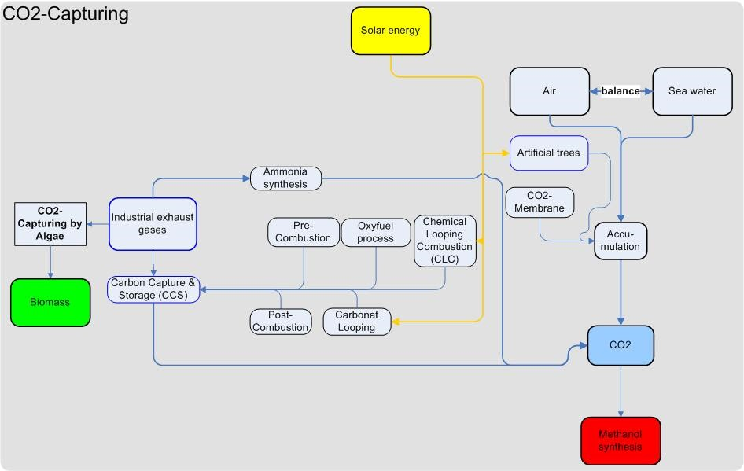

Slide 24
Manufacturer | Cu (atom%) | Zn (atom %) | Al (atom %) | Other | Patent date
IFP | 45-70 | 15-35 | ~ 20 | Zr-2-18 | 1987
ICI | 20-35 | 15-50 | 20-Apr | Mg | 1965
BASF | 38.5 | 48.8 | 12.9 |  | 1978
Shell | 71 | 24 |  | Rare Earth oxides-5 | 1973
Sud shemie | 65 | 22 | 12 |  | 1987
Dupont | 50 | 19 | 31 |  | None found
United catalysts | 62 | 21 | 17 |  | None found
Haldor Topsoe (MK-121) | >55 | 21-25 | 10-Aug |  | None found

Slide 25
Synthesis of Dimethyl ether
Catalyst | CO₂ conversion/ | Selectivity/mol.%
 | mol.% | DME | CH₃OH | CO
CZA/HZ | 11.7 | 16.0 | 6.8 | 77.2
1La-CZA/HZ | 25.1 | 17.3 | 6.4 | 76.3
2La-CZA/HZ | 43.8 | 71.2 | 4.3 | 24.6
4La-CZA/HZ | 34.6 | 30.6 | 9.2 | 60.1
6La-CZA/HZ | 40.5 | 37.2 | 5.5 | 57.4
8La-CZA/HZ | 29.5 | 27.9 | 13.8 | 86.0
Notes:
The methanol synthesis catalysts, CuO-ZnO-Al2O3
with the molar ratio of Cu:Zn:Al=6:3:1, and CuO-ZnOAl2O3
containing 1 wt.%–10 wt.% of La2O3 were prepared
by co-precipitation as follows. Cu(NO3)2・3H2O,
Zn(NO3)2・6H2O, Al(NO3)3・9H2O, with/without
La(NO3)2・6H2O were dissolved in deionized water to get
the metal nitrates solution with the total molar concentration
of 0.2 mol/L and an aqueous solution of Na2CO3
(0.2 mol/L) as precipitating agent were added drop-wise
in 200 ml deionized water to precipitate out the precursor
of methanol synthesis catalyst under stirring at a temperature
of 70 oC, while the pH of the slurry was carefully
maintained at 7.0―

Slide 26
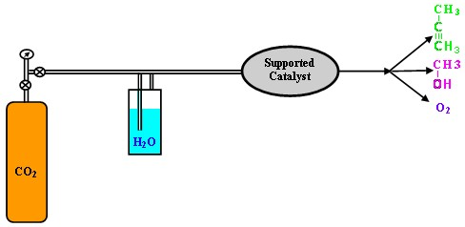
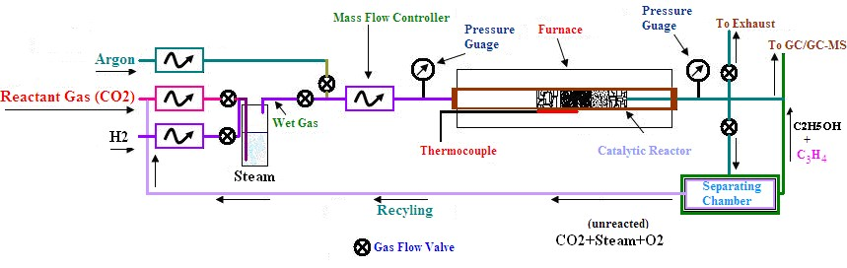
CO2 to hydrocarbons
5CO2 + 3H2O + 2H2 ➔ C2H5OH + C3H4 + 6O2
Notes:
**Preparation of supported catalyst
solution of ruthenium trichloride (0.103 g), manganese nitrate tetrahydrate (2.285 g) and nickel nitrate hexahydrate (2.47 g) (analar grade BDH Chemicals Ltd) in deionized water, acidified with dilute hydrochloric acid to prevent the precipitation of hydroxide was prepared. A portion of the slurry (10 cm³) was added to the titanium dioxide catalyst support (3.95 g), (350 m²g⁻¹) catalyst support in an evaporation basin and the mixture was magnetically stirred. The slurry was stirred for 20 minutes and dried at 395 K overnight. The prepared catalyst sample was calcined in air for 6 hours at 600 °C. Different loadings of Ru, Mn and Co ranging from 2-3% Ru, 20-30% Ni, 15-20% Mn were prepared and subjected to catalytic testing. The sample with 2% Ru, 20%Ni, 15%Mn was found to be best, and finally selected for further characterization and catalytic testing. The sample was designated as SM-1.
**

Slide 27
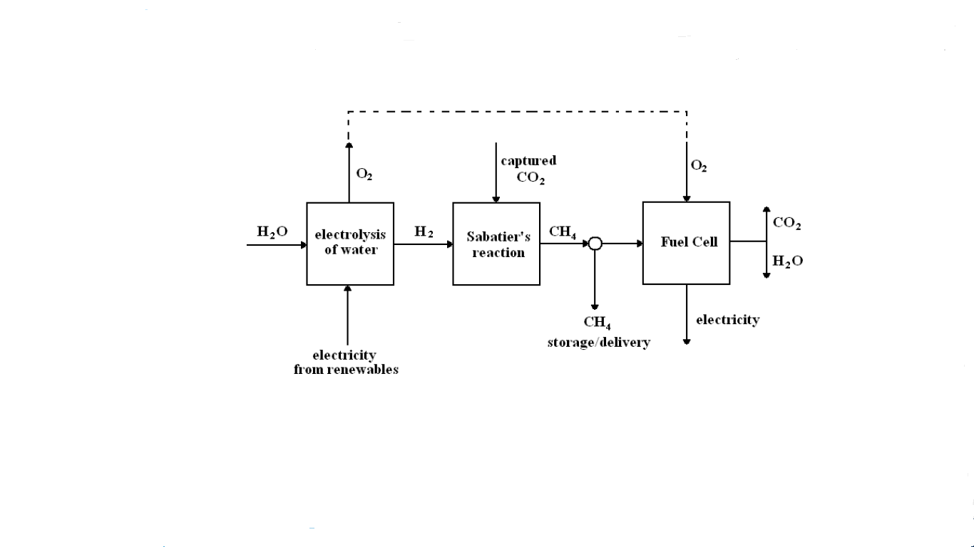
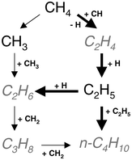
Synthesis of methane
CO2 + 4 H2 ➔ CH4 + 2 H2O H (- 164.9 KJ/mol)

Slide 28
CO2 coupling reactions

Slide 29
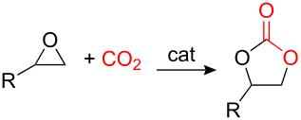
Important reactions of CO2
Synthesis of cyclic carbonate from CO2 and epoxide
Applications of the carbonate

Slide 31
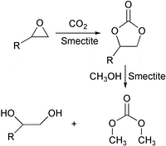

Reaction of CO2 and propylene glycol (PG)
Cyclic carbonate can be used to produce chain carbonate via
Trans-esterification which is a widely used method for carbonate synthesis. On the surface of CeO2–ZrO2, Bu2SnO, and Bu2Sn(OMe)2.
Notes:
Clay minerals are hydrous aluminium phyllosilicates, sometimes with variable amounts of iron, magnesium, alkali metals, alkaline earths, and other cations. Clays form flat hexagonal sheets similar to the micas. Clay minerals are common weathering products (including weathering of feldspar) and low temperature hydrothermal alteration products. Clay minerals are very common in fine grained sedimentary rocks such as shale, mudstone, and siltstone and in fine grained metamorphic slate and phyllite.

Slide 32
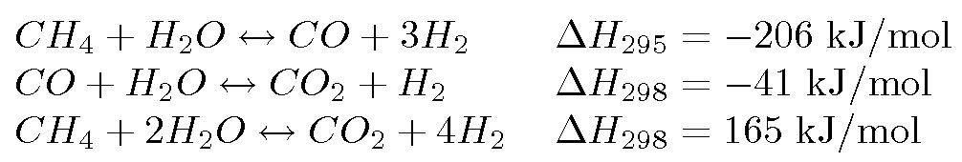
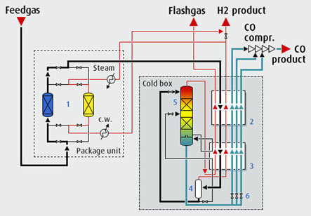
Reforming, definition and the following products
CO2 + CH4 = 2CO+ 2H2
applications of syngas

Slide 33
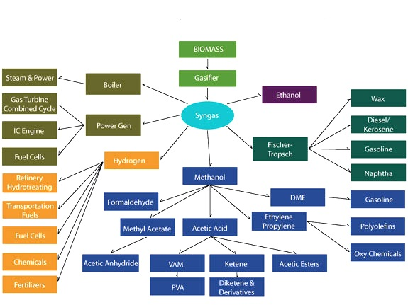
Total products of syngas

Slide 34
Syngas conversion

Slide 35
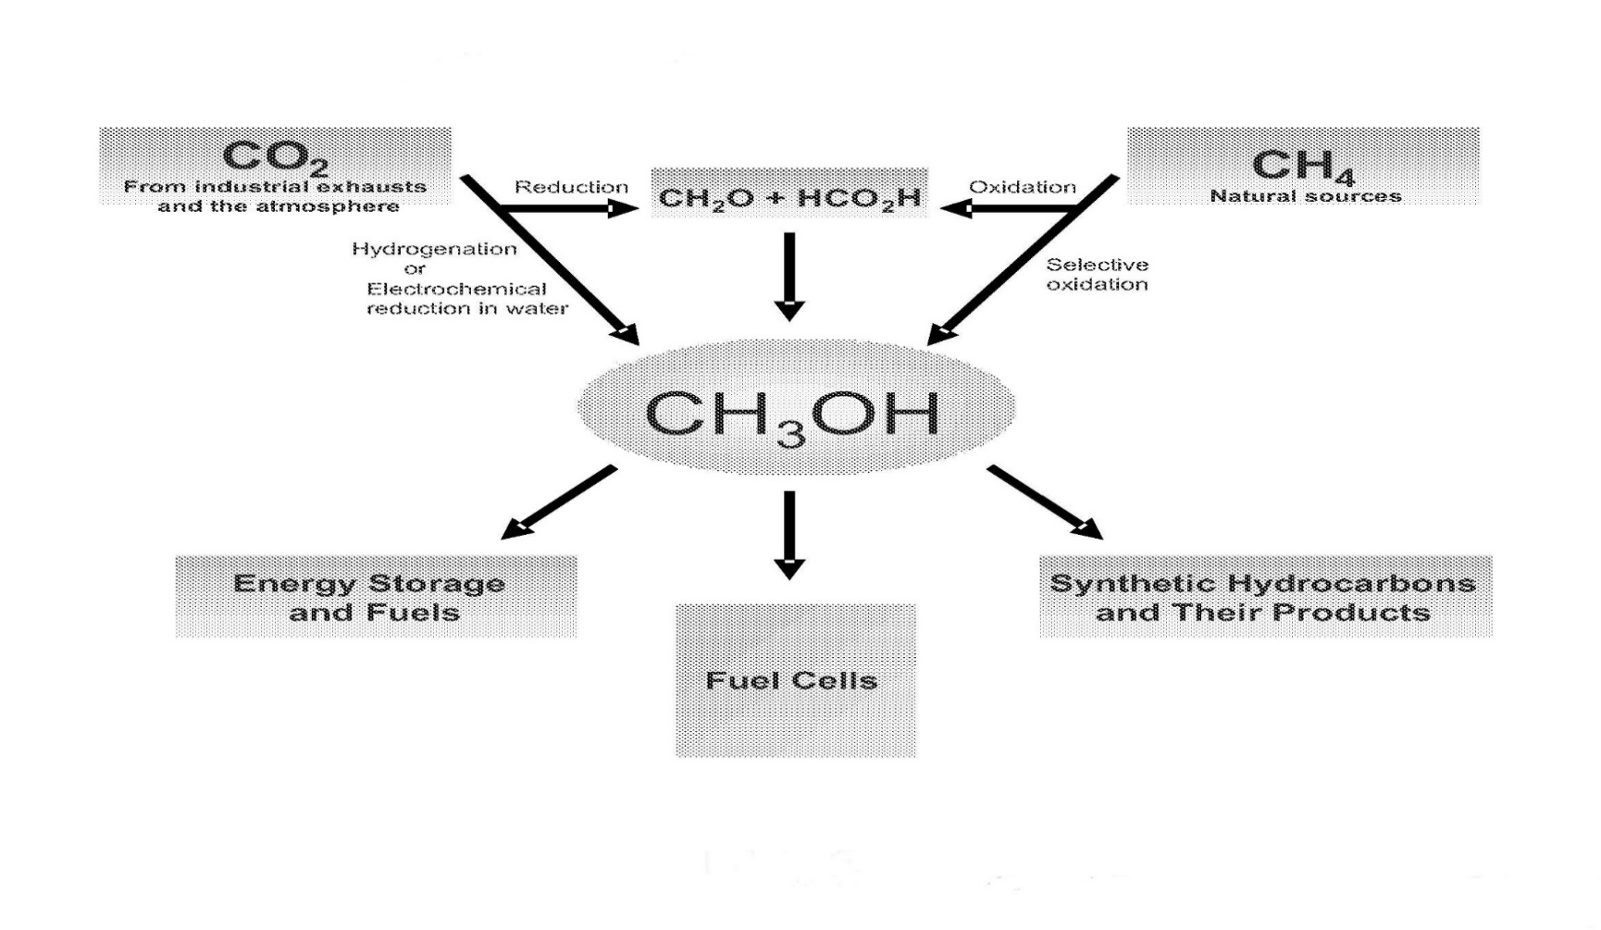
The methanol process economy

Slide 36
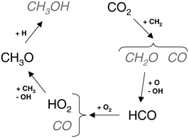
Synthesis of methanol
Notes:
**In its simplest form, syngas (also called producer gas, town gas, blue water gas, and synthesis gas among others) is composed of carbon monoxide (CO) and hydrogen (H₂), which provide the building blocks to produce a number of organic compounds. During the 1800’s, coal gasificaation was used for lighting and heating. The production of fuels and chemicals from syngas began in the early 20th century. Today, methanol and ammonia are produced from syngas and in addition to hydrogen, constitute its major uses.
In principle, syngas can be produced from any hydrocarbon feedstock, including natural gas, naphtha, residual oil, petroleum coke, coal, and biomass. Using numerous synthesis pathways, a large number of organic compounds can be produced from syngas.

Slide 37
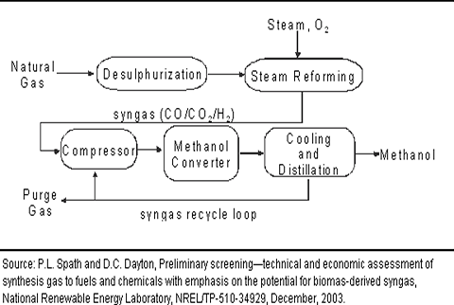
Simplified process flow diagram of methanol synthesis

Slide 38
Conversion of syngas and olefins to ketons
use of cationic palladium(II)
Alcohols/aldehydes
R
+
CO/H
Oligomers/polymers
2
Monoketones

Slide 39
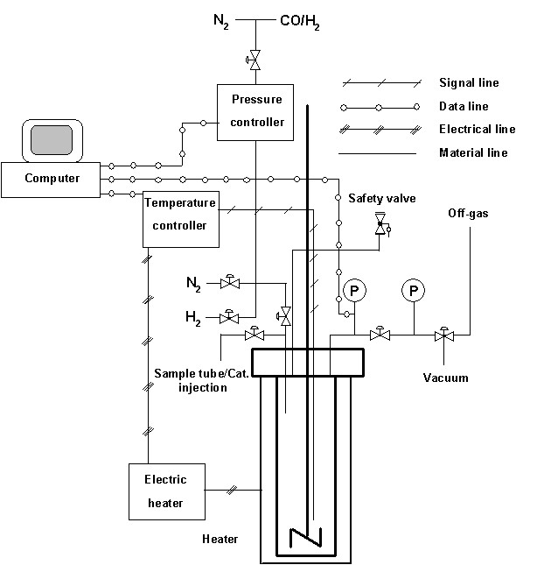
Notes:
**The catalyst was freshly prepared before each experiment under a protective nitrogen atmosphere using standard Schlenk techniques. Pd(OAc)₂ (11 mg, 0.05 mmol) was dissolved in the reaction solvent (either dichloromethane or methanol, 2 mL). After approximately 10 min the diphosphine ligand (0.12 mmol) dissolved in either dichloromethane or methanol (2 mL) was added. The solution was stirred for 10 min prior to the addition of HOTf (60 mg, 0.4 mmol) and stirred for another 10 minutes before use. The batch autoclave was charged with solvent (either dichloromethane or methanol, 10-18 ml), 1-pentene (4.0 ml, 36.5 mmol) or 1-octene (4.0 ml, 25 mmol) and the catalyst solution. The reactor was closed and flushed with nitrogen to remove air. The reactor was pressurised (60 bar) with synthesis gas (50/50 H₂/CO) and stirring was applied (1000 rpm). Subsequently the reactor was heated to the desired reaction temperature (30 or 125 ºC). After 5 h, the reactor was cooled to room temperature, depressurised, and flushed several times with N₂. The liquid product was filtered over silica gel to remove the catalyst.
**The catalyst precursor used in this study, (DsBPP)Pd(OTf)₂, was made in situ by mixing Pd(OAc)₂, DsBPP and trifluoromethanesulfonic acid (HOTf) in the reaction solvent.^{5,6} The catalytic reactions were carried out with two representative 1-alkenes (1-pentene and 1-octene) in two different solvents (dichloromethane and methanol). The reactions were all performed at a reaction time of 5 h and a fixed syngas pressure of 60 bar with a CO/H₂ ratio of 1. Typically, 0.14 mol% of catalyst was used for 1- pentene and 0.20 mol% for 1-octane

Slide 40
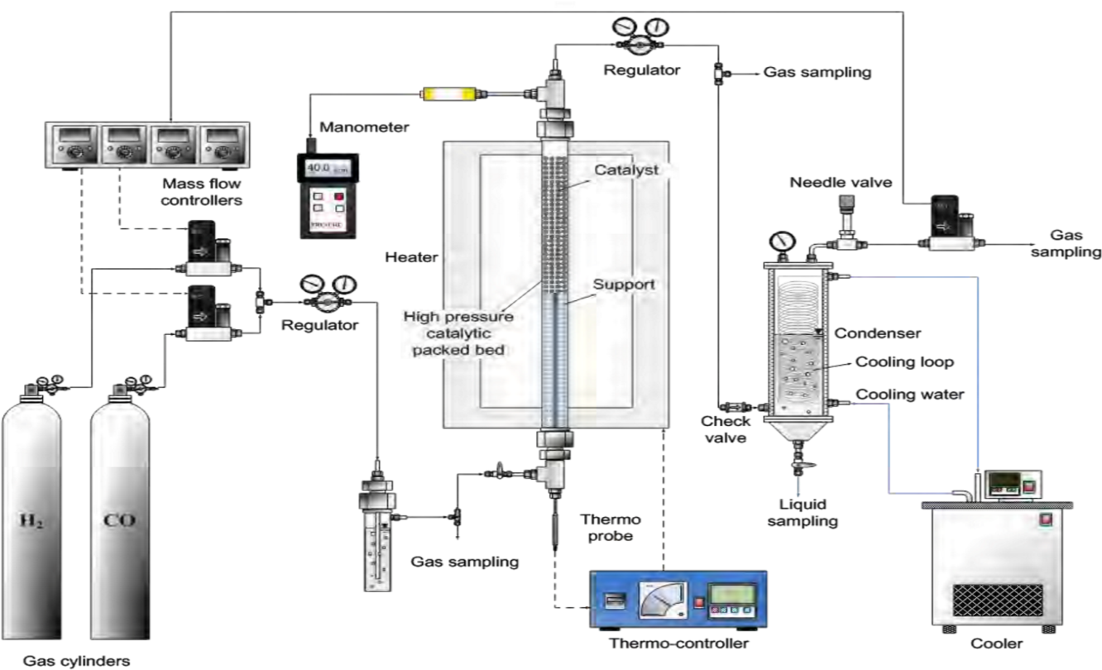
synthetic alcohol from syngas
-

Slide 41
Use of MoS₂/γ-Al₂O₃ as a catalyst
T (K) | Conversion (%) |  |  |  | Selectivity (%)
 |  | CH₄ | C2H6 | C3H8 | C4H10 | CH₃CHO | MeOH | EtOH | PrOH | BuOH
423 | 0.59 | 1.19 | 0.74 |  |  | 31.12 | 16.69 | 36.43 | 6.53 | 7.30
473 | 2.09 | 6.88 | 8.06 |  |  | 22.50 | 6.38 | 54.02 | 0.30 | 1.86
523 | 8.10 | 10.85 | 12.84 | 3.00 |  | 7.48 | 11.29 | 51.98 | 2.27 | 0.29
573 | 8.19 | 34.57 | 14.06 | 9.58 | 0.48 | 6.28 | 6.21 | 28.28 | 0.39 | 0.16
P_{ST} (MPa) | Conversion (%) |  |  |  |  | Selectivity (%)
 |  | CH₄ | C2H6 | C3H8 | C 4H1 0 | CH₃CH O | MeOH | EtOH | PrOH | BuOH
1.5 | 4.6 | 11.84 | 15.01 | 11.21 |  |  | 9.93 | 50.92 | 2.47
2.4 | 6.48 | 12.05 | 14.04 | 3.08 |  | 7.27 | 11.29 | 50.00 | 2.27
3.0 | 8.10 | 10.85 | 12.84 | 3.00 |  | 7.48 | 11.29 | 51.98 | 2.27 | 0.29
3.6 | 9.57 | 12.46 | 12.63 | 2.96 |  | 3.71 | 13.94 | 51.16 | 2.86 | 0.28

Slide 42
Main products are ethanol and methane respectively
Q_{G} (mL min⁻¹) | Conversion (%) |  |  |  |  | Selectivity (%)
 |  | CH₄ | C2H6 | C3H8 | C4H10 | CH₃CHO | MeOH | EtOH | PrOH | BuOH
300 | 8.10 | 10.85 | 12.84 | 3.00 |  | 7.48 | 11.29 | 51.98 | 2.27 | 0.29
450 | 5.44 | 10.54 | 12.95 | 2.52 |  | 7.54 | 10.91 | 52.91 | 2.37 | 0.26
600 | 4.83 | 10.41 | 12.18 | 2.70 |  | 7.82 | 11.16 | 53.14 | 2.34 | 0.25
900 | 4.12 | 10.25 | 12.14 | 2.68 |  | 8.38 | 11.39 | 52.50 | 2.40 | 0.26
Notes:
**In HPFPB system, the main organic products of alkane and alcohols of MoS₂/γ-Al₂O₃ catalytic synthesis are ethanol and methane, respectively. From the previous results shown, ethanol selectivity decreases at all temperatures when methane is the major product. For this reason, setting the reaction temperature at T = 523 K is the optimal set point which not only yields more alcohol products, especially for higher S_{EtOH}, but also restrains the amount of alkanes formed. Furthermore, it could increase S_{EtOH} versus CH₄ while setting the H₂/CO feed ratio as 2. C onsidering the effects of P_{ST} and Q_{G}, there are similar trends for both of alkane and alcohol products besides of the trend for the conversion of CO. Increasing the flow rate would decrease X_{CO} because the retention time is too small to finish more number of completed reactions.
Taken together, these observations suggest that setting the parameter as T = 523 K, H₂/CO = 2, higher pressure, and lower flow rate to reach the purpose of obtaining higher X_{CO} and outstanding S_{EtOH}.

Slide 43
Ethanol synthesis from syngas
Nomenclature | Composition (wt %)^{b} | molar ratio of promoter/Rh | Metal loading method
Rh(1.5)/SiO₂ | 1.5 |  | impregnation
Rh(1.5)-La(2.6) /SiO₂ | 1.5, 2.6 | La/Rh = 1.3 | co-impregnation
Rh(1.5)/V(1.5) SiO₂ | 1.5, 1.5 | V/Rh = 2 | sequential impregnation
Rh(1.5)-La(2.6)/V(0.7)/ SiO₂ | 1.5, 2.6, 0.7 | La/Rh = 1.3 V/Rh=1 | co-sequential impregnation ^{c}
Rh(1.5)-La(2.6)/V(1.5)/ SiO₂ | 1.5, 2.6, 1.5 | La/Rh = 1.3 V/Rh=2 | co-sequential impregnation
Rh(1.5)-La(2.6)/V(2.2)/ SiO₂ | 1.5, 2.6, 2.2 | La/Rh = 1.3 V/Rh=3 | co-sequential impregnation
Rh(1.5)-La(2.6)/V(3.7)/ SiO₂ | 1.5, 2.6, 3.7 | La/Rh = 1.3 V/Rh=5 | co-sequential impregnation
Rh(1.5)-La(0.5)/V(3.7)/ SiO₂ | 1.5, 0.5, 3.7 | La/Rh = 0.3 V/Rh=5 | co-sequential impregnation
Rh(1.5)-La(4)/V(1.5)/ SiO₂ | 1.5, 2.6, 1.5 | La/Rh = 2 V/Rh=2 | co-sequential impregnation
Rh(1.5)-La(6)/V(1.5)/ SiO₂ | 1.5, 6, 1.5 | La/Rh = 3 V/Rh=2 | co-sequential impregnation
Notes:
**It has been reported widely that promoted Rh-based catalysts can exhibit high selectivity to C₂₊ oxygenates during CO hydrogenation. The doubly promoted Rh-LaV/SiO₂ catalysts exhibited higher activity and selectivity for ethanol and other C₂₊ oxygenates than singly promoted catalysts. The better performance appears to be due to a synergistic promoting effect of the combined La and V additions through intimate contact with Rh.

Slide 44
Conclusions
By the increasing rate of carbon dioxde production all over the world, an effort is crucial.
Between several answers to lower the amount of release, conversion seems to be more suitable.
By the researches has been carried out so far, converting carbon dioxide has become more` common.
CO2 can be changed to important chemical compounds, such as methanol, formic acid, ethylene and methane, which all are super important precursors for organic synthesis.
Annual budget of U.S. on CO2 researches might show the importance of the issue.
As a commercial point of view to the CO2, it’s really interesting to change an easy-made & cheap gas to products of value that can be sold.
New American plan on the polymerization of the CO2 to plastics, synthesizing CO2 based monomers and then polymerization, might change the future of the most consumable goods.

Slide 45
References
[1] (http://www.epa.gov/climatechange/effects/health.html)
[2] http://www.epa.gov/climatechange/effects/agriculture.html
[3] http://www.epa.gov/climatechange/effects/eco.html
[4] http://www.epa.gov/climatechange/effects/coastal/index.html
[5]http://www.epa.gov/climatechange/effects/water/index.html [6]http://leahy.senate.gov/issues/FuelPrices/EnergyIndependenceAct.pdf
[7]The Power to reduce CO2 Emissions: The Full Portfolio, The EPRI Energy Technology Assessment Center, August 2007 .
[8] William H. Schlesinger, dean of the Nicholas School of the Environment and Earth Sciences at Duke University, in Durham, North Carolina.
[9] Climate Change 2007: Synthesis Report, Intergovernmental Panel on Climate Change.
[10] http://www.netl.doe.gov/technologies/coalpower/cctc/.
[11] Understanding and responding to climate change, 2008 edition’, The National Academies, National Academy of Sciences .
[12] S.C. Roy, O.K. Varghese, M. Paulose, C.A. Grimes, Toward solar fuels: Photocatalytic conversion of carbon dioxide to hydrocarbons, ACS Nano 3, 1259 (2010).
[13] M. C. M. van de Sanden, J. M. de Regt, G. M. Janssen, J. A.M. van der Mullen, B. van der Sijde, and D. C. Schram, Rev. Sci. Instrum. 63, 3369 (1992) .
[14] R. F. G. Meulenbroeks, D. C. Schram, L. J. M. Jaegers, and M. C. M. van de Sanden, Phys. Rev. Lett. 69, 1379 (1992).
[15] Mikkelsen M, Jørgensen M, Krebs FC. The teraton challenge. A review of fixation and transformation of carbon dioxide. Energy Environ Sci2010;3(1):43–81.

Slide 46
[16] Xu XC, Song CS, Miller BG, Scaroni AW. Influence of moisture on CO2 separation from gas mixture by a nanoporous adsorbent based on polyethylenimine-modified molecular sieve MCM-41. Ind Eng Chem Res
2005;44(21):8113–9.
[17] Shukla R, Ranjith P, Haque A, Choi X. A review of studies on CO2 sequestration and caprock integrity. Fuel 2010;89(10):2651–64.
[18] Bredesen R, Jordal K, Bolland O. High-temperature membranes in power generation with CO2 capture. Chem Eng Process 2004;43(9):1129–58.
[19] Barelli L, Bidini G, Gallorini F, Servili S. Hydrogen production through sorption-enhanced steam methane reforming and membrane technology: a review. Energy 2008;33(4):554–70.
[20]

Slide 47


Slide 48


